Slide 1

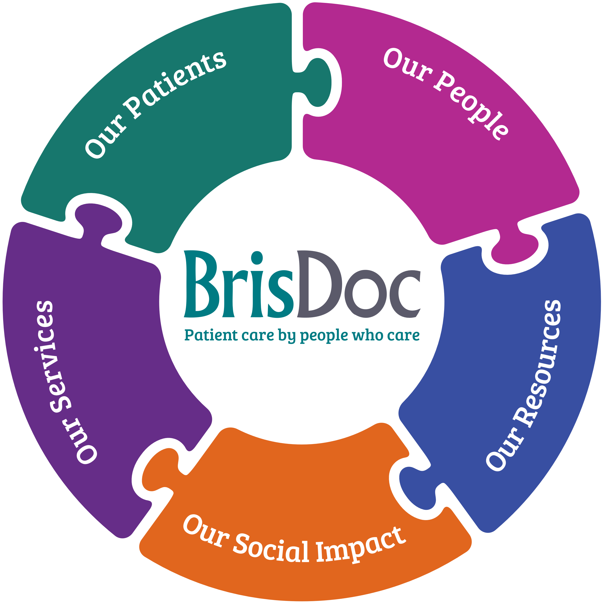
Co-Owners Council January 2023

Slide 2
48 questions that help us to improve…
What We Do & The Way We Do It
Culture & Behaviours
Reputation & Brand
Delivery & Performance
Continuous Improvement Cycle
Notes:
The way we do things around here – operational as well as leadership / people emphasis
Also Scoring places emphasis on consistency – in how we do it
Key to success is how people become involved in a continuous improvement cycle

Slide 3
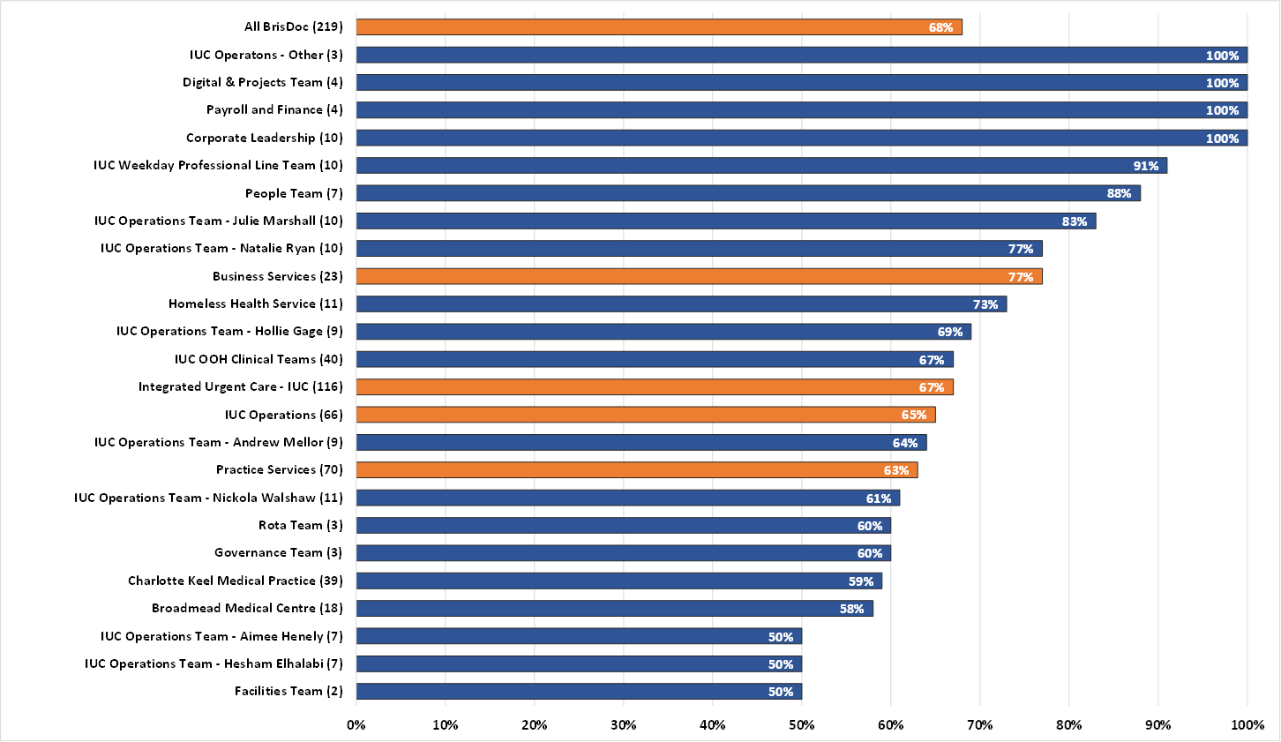
68% Responded
54% in 2021
Notes:
Open for 3 weeks in Oct a 63% response rate is fantastic. I actually had a hopped we would hit 70% but maybe next year. Generally, employee survey participation rates fall between the 65-85%

Slide 4
It’s a Journey
Journey of continuous improvement
‘Under-performing’ < 49’
‘Similar to rest’ > 49
‘Clearly the best’ > 67
'Truly differentiated‘ > 79
Notes:
The scores are arrived at by weighting the different responses: Always=1, Mostly=0.6, Sometimes= 0.3, Rarely = 0.1 and Never = 0 and multiplying these by the % responding with each option.
Since starting the survey in 2019 the Cultural score has gradually increased, possibly despite of, or perhaps because of, Covid and the way BrisDoc as an employer and managers and colleagues responded. So it’s a journey and we are in the Clearly the best space and further improvement may be more difficult as there is less obvious things we can do that will have a significant impact.

Slide 5
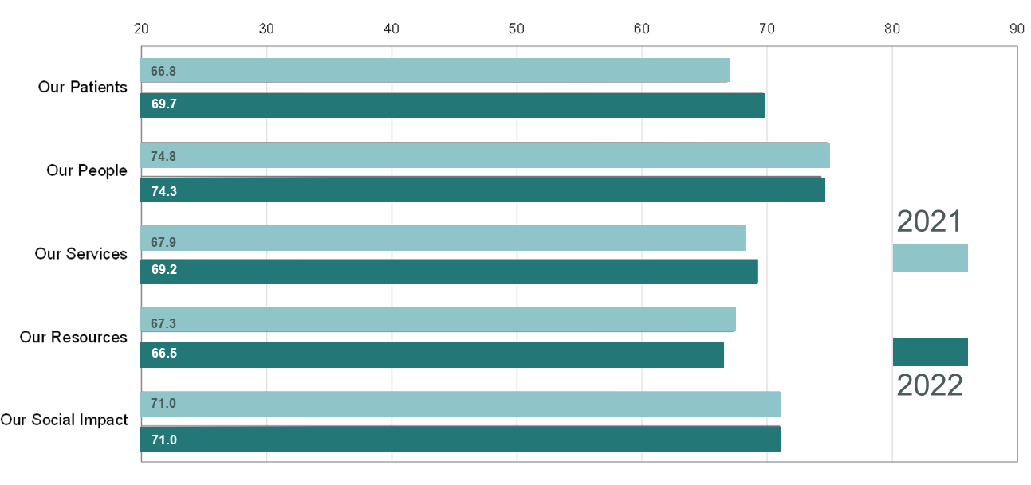
Mapped Against Our values
‘Under-performing’ < 49’
‘Similar to rest’ > 49
‘Clearly the best’ > 67
'Truly differentiated‘ > 79
Notes:
Our People is once again the highest scored value reflecting our culture, wellbeing focus, Our Resources is the lowest scored value as it was last year. This reflects two things – IT and number of people. But all values are actually strong at or above the ‘Clearly the best’ benchmarking from Learnership.

Slide 6
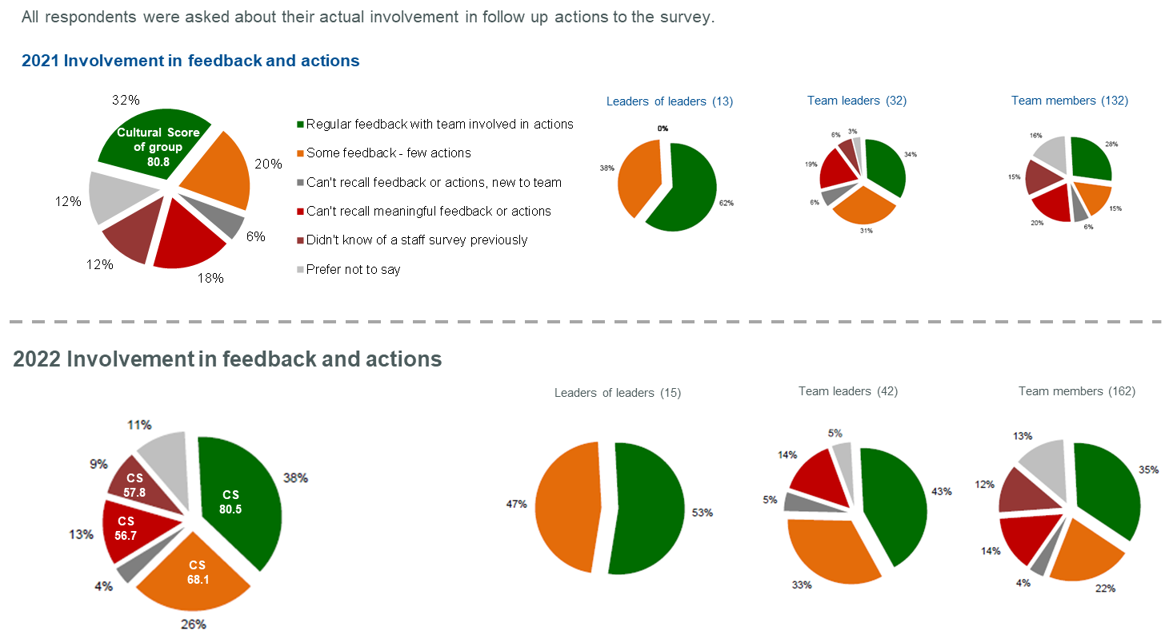
Notes:
About how involved you have been from the 2021 survey. We saw an increase in the regular feedback and involved in actions from 32% to 38% but this could be much higher.
The groups responding with Green: regular involvement and feedback is above 80.

Slide 7
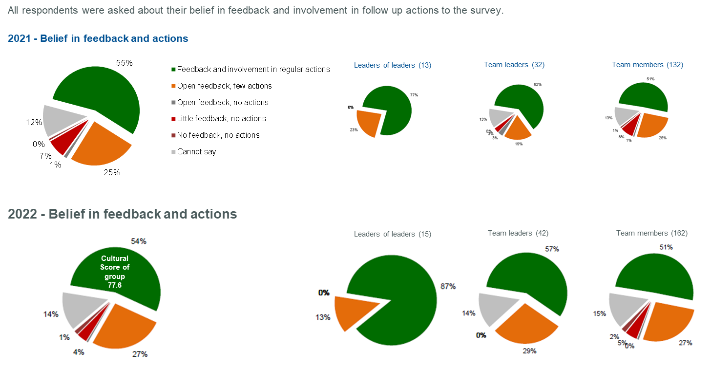
Notes:
Leaders of leaders the belief has increased from 77% to 87% but dropped for Team leaders from 62% to 57% although that drop just increased the few actions.. It remained the same for team members.
Again the green belief in regular involvement and feedback is much higher.
The simple message behind this is the more feedback and involvement the better the culture.

Slide 8
A warm and caring culture, lacking consistency in critical performance areas.
Highest scoring 6 questions across the survey
Category
Score & change
Lowest scoring 6 questions across the survey

Slide 9
34 Questions improved, 14 questions fell back
Most improved questions across the survey
Category
Score & change
Changed questions
Changed question
Questions falling most across the survey
Changed question

Slide 10
Pride and advocacy in BrisDoc remains extremely strong
How likely are you to recommend BrisDoc as a place to work?
If a friend or relative needed treatment, I would be happy with the standard of care provided by BrisDoc
eNPS + 57.6
Notes:
eNPS is Employee Net Promoter Score. It measures how strongly employees would advocate and promote BrisDoc as a place to work.
Possible eNPS scores range from -100 to 100. Suitable benchmark values vary by industry and company sizes, but 10-30 is typically considered a “good” eNPS score. The threshold for an “excellent score” is typically between 50 and 70. A score above 80 is likely to be in the very top percentages in almost any industry or sector.

Slide 11
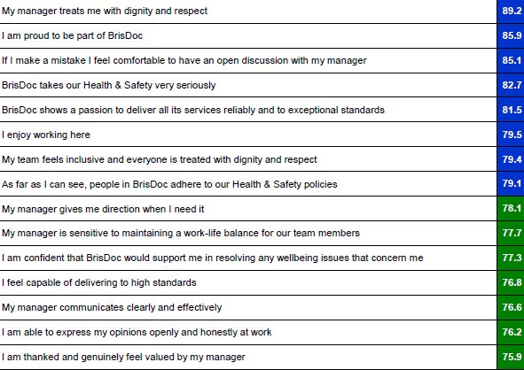
Notes:
Top 15 statements at BrisDoc level – any patterns, themes?
Safe, inclusive, genuine, supportive, respectful,
Relationship with manager and team

Slide 12
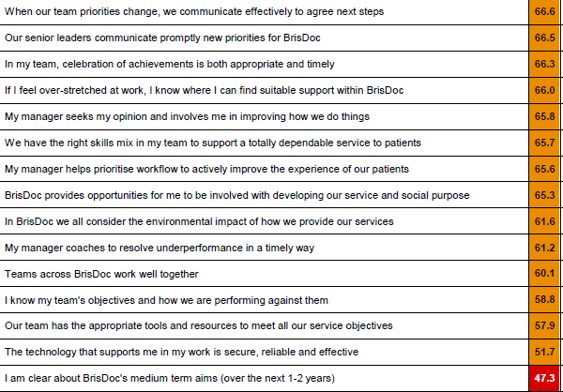
Notes:
Bottom 15 statements, again any patterns or themes?
Tools and resources, technology, knowledge of aims, goals, objectives, priorities.
Coaching, involvement in new ideas, resolving under performance.
Relationship with other teams.

Slide 13

Free text produced 62 comments about improving the workplace
Cross team working 16% (up 9%)
Workload levels 13% (down 10%)
Reward or benefits related 13%
Communication e.g. of change 11% (down 12%)
Fairness 10%
Career related 8% (up 4%)
Day to day leadership 6% (down 5%)
Processes 6%
Technology related 5%
Skills or training 5%
Not categorised 6%
….and 24 comments about improving the Patient Experience
Service related 29% (up 14%)
Processes 17% (down 5%)
Budget or finance related 17%
Organisational structure 21%
Communication e.g. of change 4% (down 3%)
Employee skills or training 4% (down 3%)
Technology related 4%
Not categorised 4%
Comments assigned to leadership team for responses

Slide 14
Next Steps
BrisDoc wide areas to focus on:
Sight, clarity, and alignment of strategy / objectives
Coaching / involvement / contribution
Collaboration / cross team working / knowledge sharing
Communications priorities / change
Pay / benefits
Services / teams:
Service results shared with leadership
Teams planning, supported by People Business partners
Increased involvement and feedback = improved culture

